Slide 1
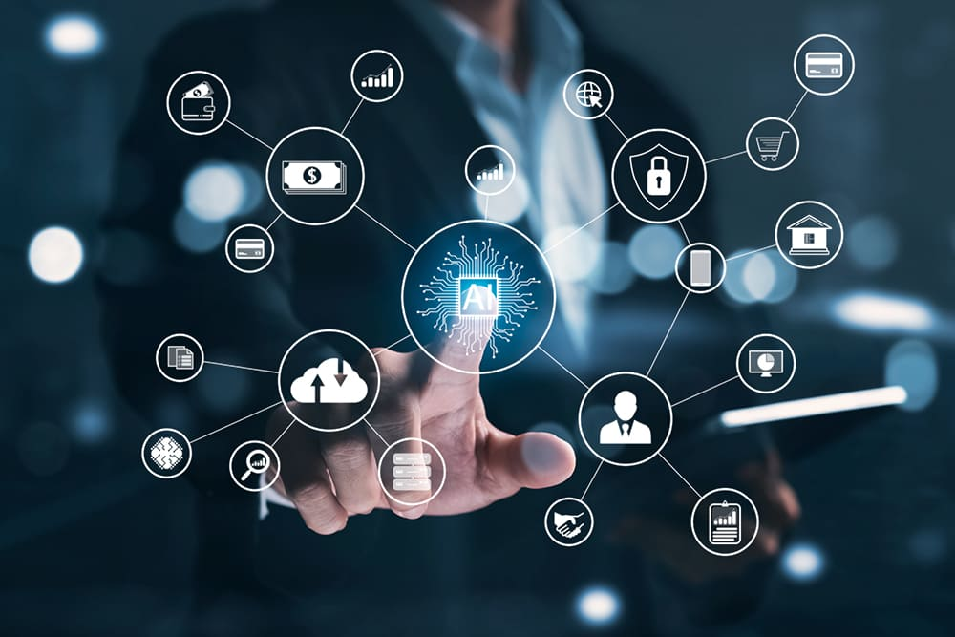

A Survey on Distributed Machine Learning

Slide 2
Group No: 8
Group Member List
Name | ID | Slides
M S R Momen Sagor | 21366022 | 1-3
Shanuma Afrin Meghla | 21166010 | 4
Md Sadaf Noor | 20366022 | 5-7
Fahim Hasan Mehedi | 17201108 | 8
Naima Nazly | 21266009 | 9

Slide 3
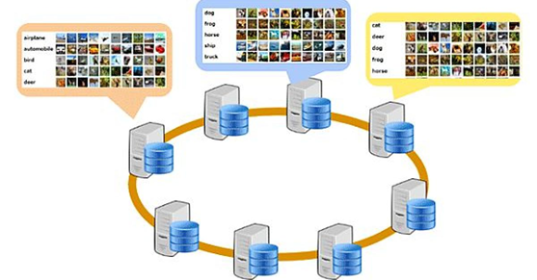

Introduction
Distributed machine learning is a multi-node ML system that improves performance, increases accuracy, and scales to larger input data sizes. It reduces errors made by the machine and assists individuals to make informed decisions and analyses from large amounts of data.
The rapid development of technologies has led to growth of data.Machine Learning (ML) algorithms are increasingly being used to analyze datasets and build decision-making systems for which an algorithmic solution is not feasible due

Slide 4
Computations in ML
System Challenges of ML & Adoption of HPC Ideas
Scaling Up
Scaling Out

Slide 5
A REFERENCE ARCHITECTURE FOR DISTRIBUTED MACHINE LEARNING
Machine Learning Algorithms
Feedback
Supervised learning
Unsupervised learning
Semi-supervised learning
Reinforcement learning

Slide 6
A REFERENCE ARCHITECTURE FOR DISTRIBUTED MACHINE LEARNING
Machine Learning Algorithms
Purpose
Anomaly detection
Classification
Clustering
Dimensionality reduction
Representation learning
Regression

Slide 7
A REFERENCE ARCHITECTURE FOR DISTRIBUTED MACHINE LEARNING
Machine Learning Algorithms
Method
Evolutionary Algorithms (EAs)
Stochastic Gradient Descent (SGD)
Support Vector Machines (SVMs), Perceptrons, Artificial Neural Networks (ANNs), Deep Neural Networks (DNNs), Convolutional Neural Networks (CNNs/ConvNets), Recurrent Neural Networks (RNNs), Hopfield Networks, Self-Organizing Maps (SOMs)/Self-Organizing Feature Maps (SOFMs), Stochastic Neural Networks, Auto-encoders, Generative Adversarial Networks (GAN)
Rule-Based Machine Learning (RBML) Algorithms
—Association Rule Learning
—Decision Trees,
Topic Models (TM)
—Latent Dirichlet Allocation
—Latent Semantic Analysis (LSA)/Latent Semantic Indexing (LSI)
—Naive Bayes Classifiers
—Probabilistic Latent Semantic Analysis (PLSA)/Probabilistic Latent Semantic In-
dexing (PLSI)
Matrix Factorization

Slide 8
Distributed ML Ecosystems
General Purpose Frameworks
Storage
Compute
Natively Distributed ML Systems
Different way of implementations
ML In Cloud
Cloud operators offering distributed ML services
Ex: Google Cloud, Azure and Aws

Slide 9
Performance
Fault Tolerance
Challenges & Conclusion
Privacy
Portability

